Slide 1
Incremental Evolutionary Algorithm for 8-Queens
Motivation, method, evaluation, and results
CSCI 165 project presentation
By: Ramraj Panesar and Hugo Rodriguez

Slide 2
Motivation And Problem Statement
Why This Domain Matters
Problem Addressed
8-Queens is a classic constraint satisfaction and search problem.
It is easy to visualize, but still useful for comparing optimization strategies.
It shows how a smart representation can shrink the search space dramatically.
Place 8 queens on a chessboard so that no two attack each other.
Compare an evolutionary algorithm under different population, mutation, and tournament settings.
Measure success rate, solution quality, runtime, and generations needed to solve.

Slide 3
Background And Approach
Background
Method
A valid solution has no shared rows and no diagonal conflicts.
The project uses a permutation encoding, so each column has one queen and rows do not repeat.
Fitness = 28 minus the number of attacking pairs, so 28 is perfect.
Initialize a population of random row permutations.
Use tournament selection, cut-and-crossfill crossover, and swap mutation.
Keep elite individuals and iterate until a perfect board is found or the generation budget ends.

Slide 4
Experiment Setup
30 runs per configuration with max_gens = 1000 and elitism = 2.
Population sweep: 20, 50, 100 with mutation = 0.10 and tournament = 3.
Mutation sweep: 0.05, 0.10, 0.20 with population = 100 and tournament = 3.
Tournament sweep: 2, 3, 5 with population = 100 and mutation = 0.10.
Metrics: success rate, mean best fitness, average generation solved, and runtime.

Slide 5
Evaluation Results
Summary across 30 runs per configuration
Config | Success | Mean Fitness | Avg Gen Solved | Time (ms)
pop=20 | 23/30 | 27.767 | 98.5 | 139.2
pop=50 | 30/30 | 28.0 | 9.6 | 11.5
pop=100 | 30/30 | 28.0 | 4.1 | 10.2
mut=0.05 | 30/30 | 28.0 | 5.4 | 13.2
mut=0.10 | 30/30 | 28.0 | 4.1 | 10.3
mut=0.20 | 30/30 | 28.0 | 4.1 | 10.7
tour=2 | 30/30 | 28.0 | 3.7 | 9.3
tour=3 | 30/30 | 28.0 | 4.1 | 10.3
tour=5 | 30/30 | 28.0 | 11.5 | 28.3

Slide 6
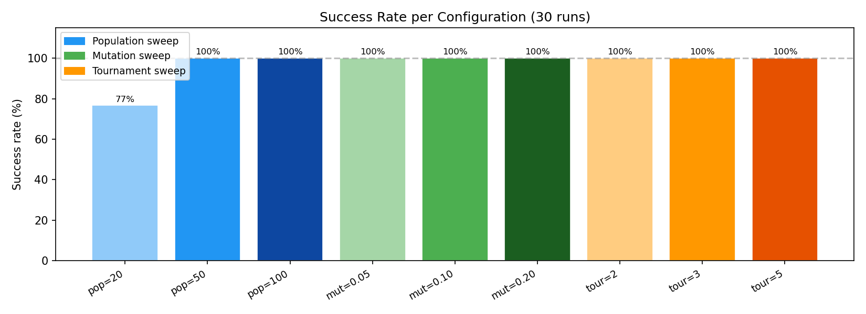
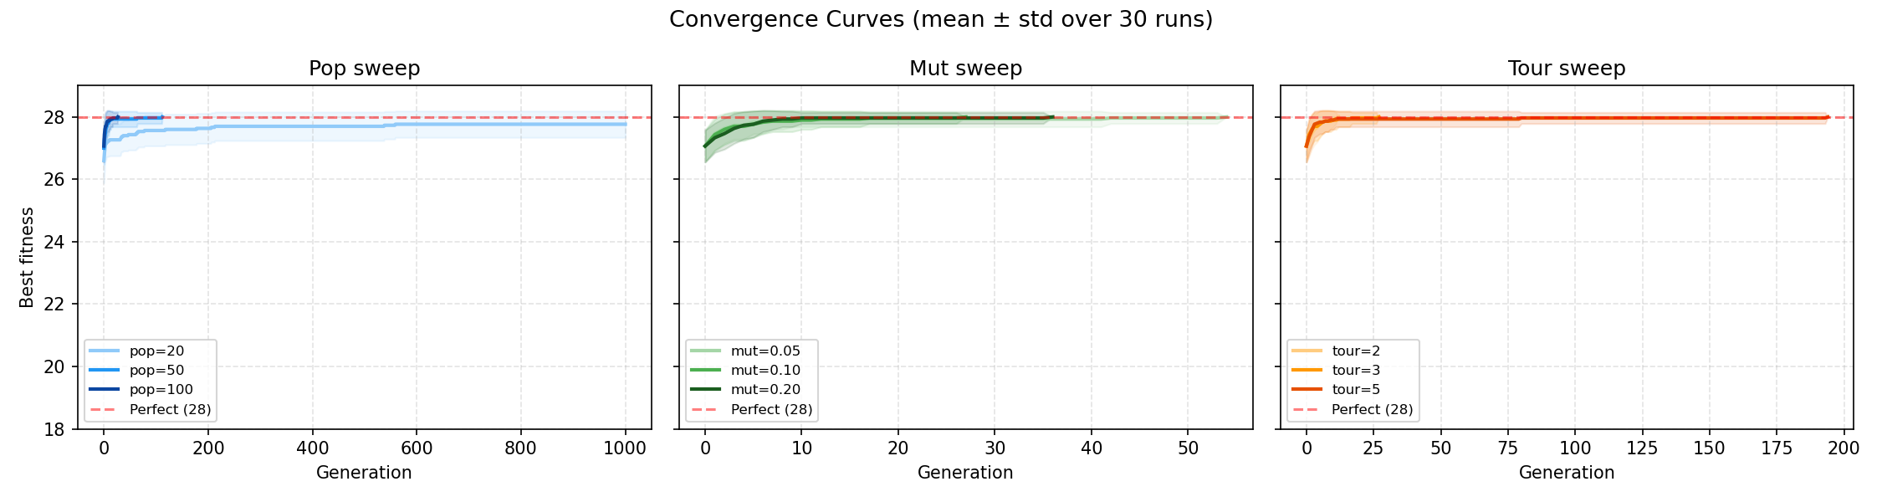
Visual Results
Success rates show that `pop=20` was the only configuration with notable failures.
Convergence curves show the stronger settings reaching perfect fitness quickly.

Slide 7
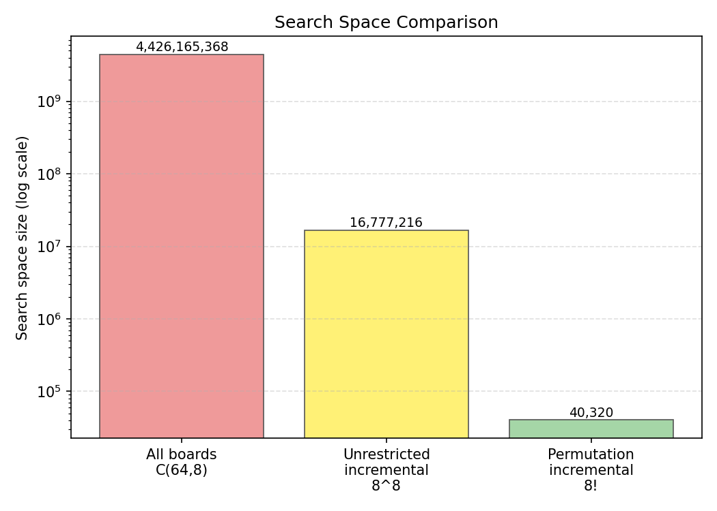
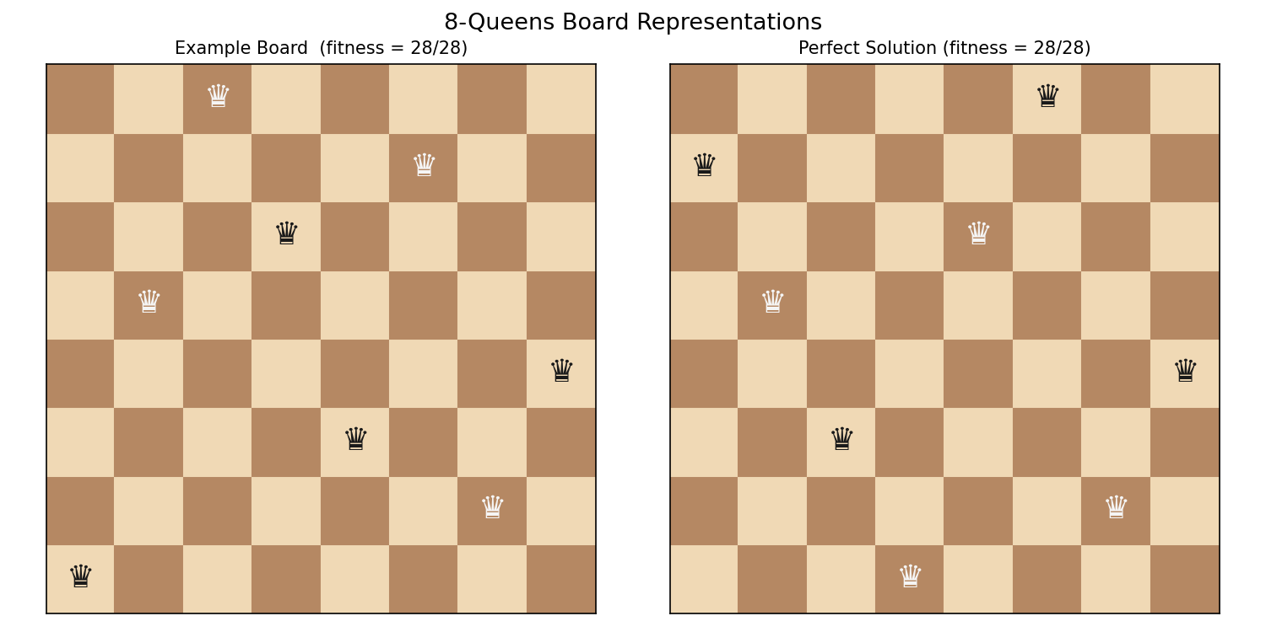
Representation And Example Boards
Permutation encoding reduces the search space from billions of boards to 40,320 candidates.
The board visualization makes conflicts and solved states easy to explain.

Slide 8
Conclusions And Future Work
The permutation encoding was the key design choice because it removed many invalid boards before search even began.
Most tested settings solved the problem perfectly in all 30 runs; `pop=20` was the weakest at 23/30 successes.
Population sizes of 50 and 100 provided perfect success with fast convergence, while higher tournament pressure slowed solving.
Future work: test larger N-Queens variants, compare against hill climbing or simulated annealing, and vary crossover and elitism.

